Slide 1
Apply Effective Communication
ED125 CRLA Certified Tutor Training Class- Regular Level

Slide 2
How well do you Communicate?
You have assessed your skills.
Share with another what you learned about yourself and how you hope to improve your skills.

Slide 3
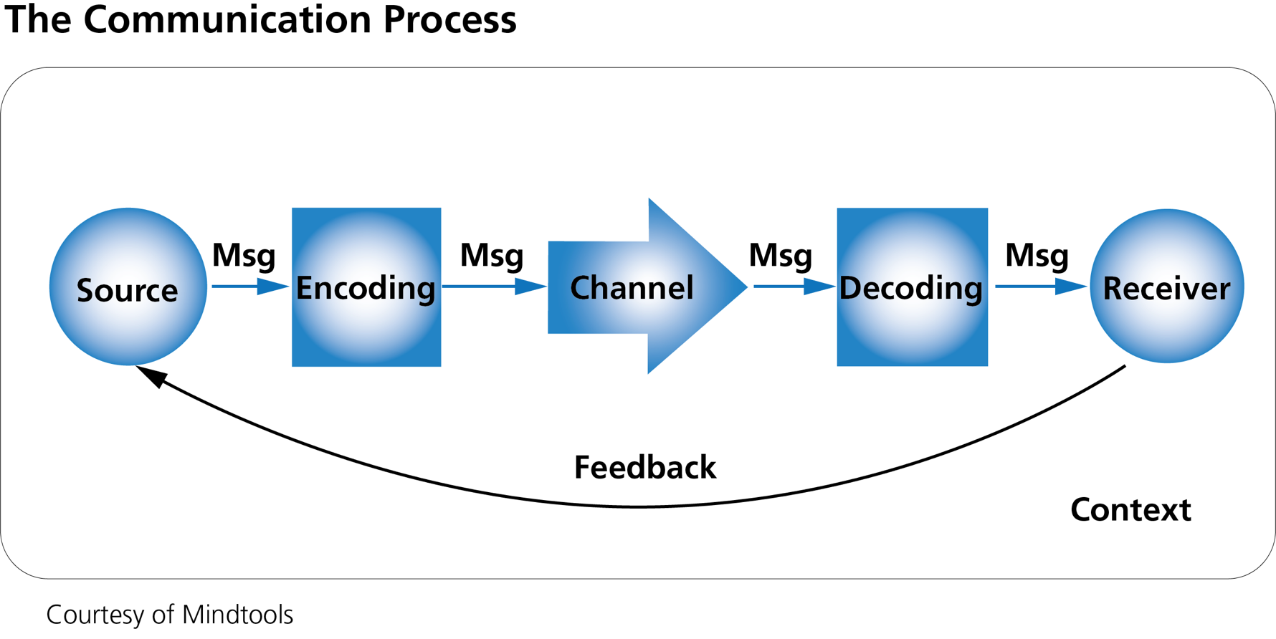
The Communication Process
Make notes in your handout packet.

Slide 4
Listening Filters Make notes in your handout booklet
Attention ‑ An individual's listening span is brief. It is extremely easy to become "mentally derailed" while listening to someone only two feet away.
Understanding ‑ In a ten‑minute conversation a person will hear between 500 and 1000 words. No matter how closely he listens, some of these words are apt to have different meanings to him than to the speaker.
Speed ‑ People think much faster than they speak. Since the listener's thoughts are ahead of the speaker it is easy to allow them to wander while waiting for the speaker to catch up.
Environment ‑ Physical factors can affect listening as much as mental factors. Uncomfortable seats, noisy neighbors, poor lighting, and disagreeable temperatures can make listening difficult.
Bias ‑ Many people do not listen objectively. They tend to interpret what they hear in terms of their prejudices, moods, and their attitudes toward the topic and speaker.

Slide 5
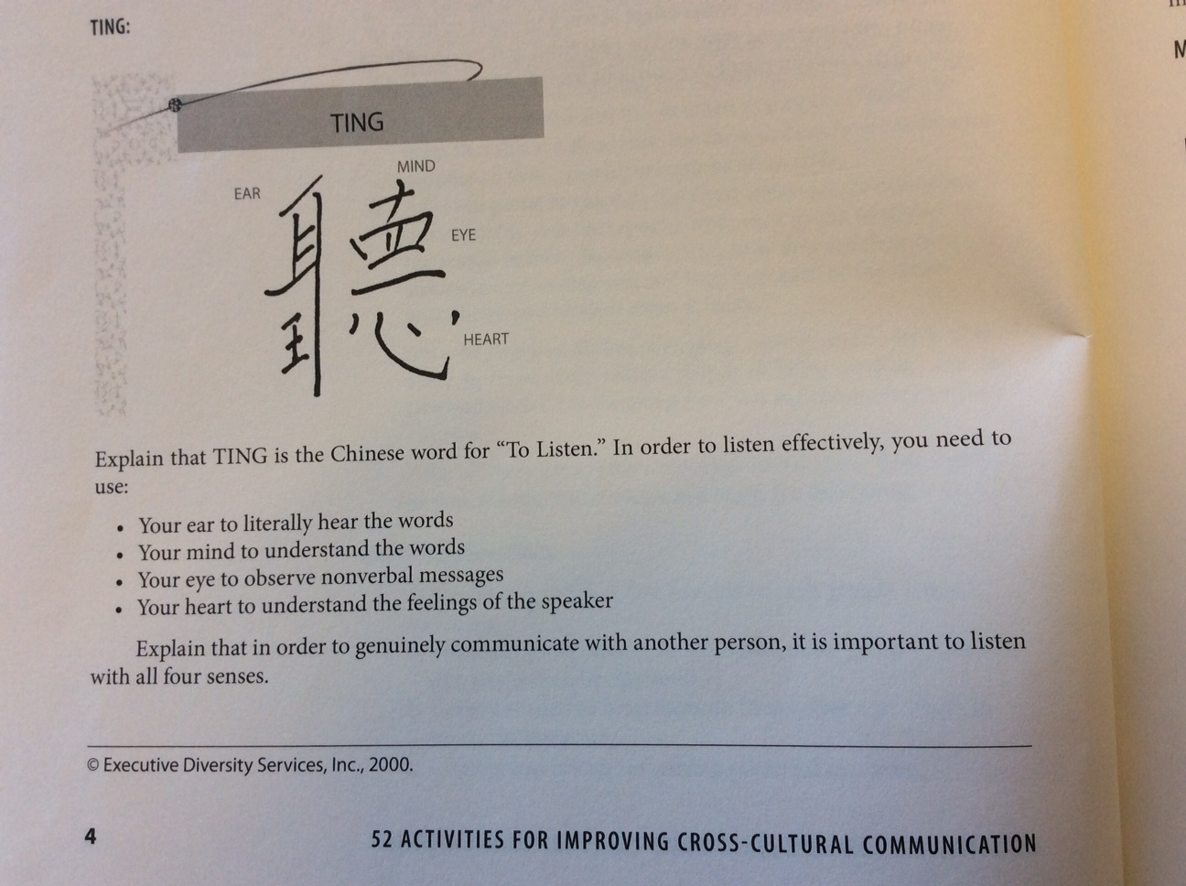
TING

Slide 6
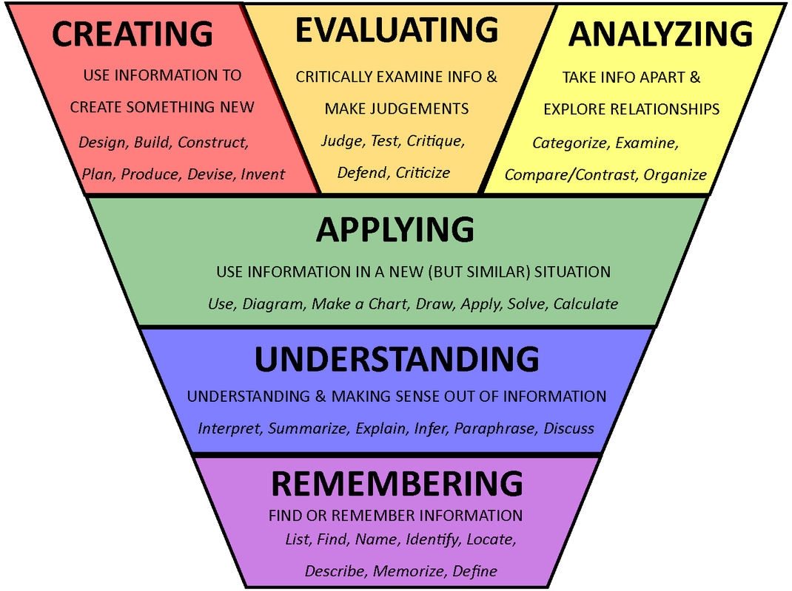
Blooms Taxonomy

Slide 7
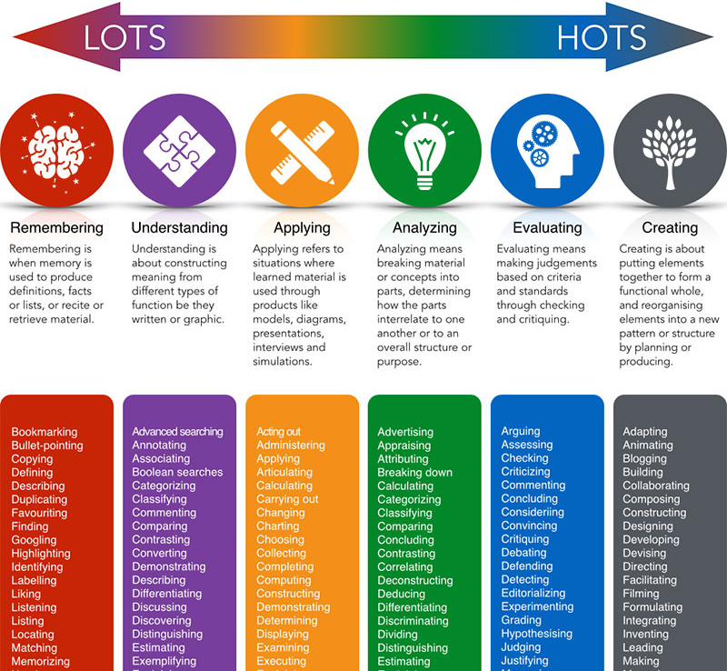
Questions to Ask

Slide 8
Apply Blooms Taxonomy
What kinds of questions do you normally (habitually) ask your students?
Can you select 1-2 questions from the “remembering” and “understanding “ levels that you will intentionally and appropriately add to your tutor sessions.
Think about your own learning:
What level of thinking are you expected to use in one of your classes?
What question from that level of thinking can you add to help you apply, analyze or create something?

